Slide 1



Slide 2


Slide 3


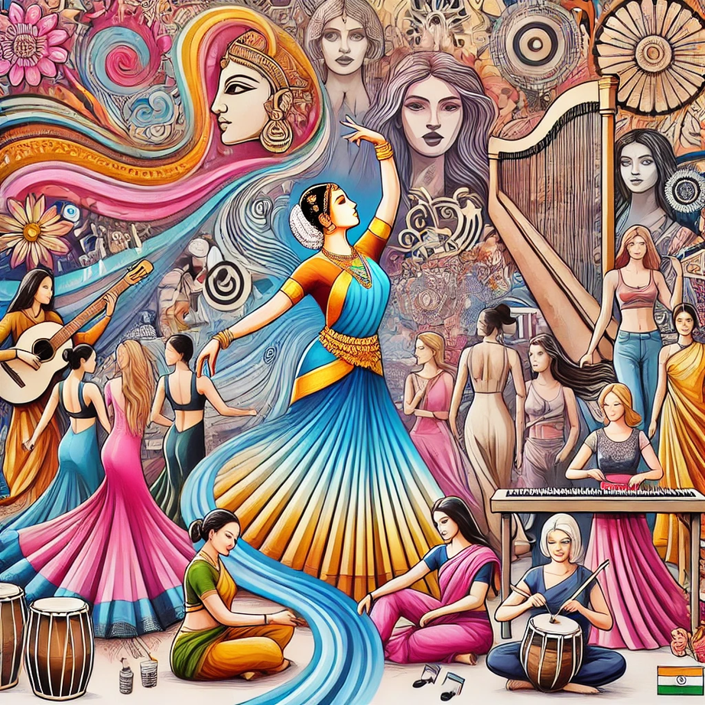



BLENDING TRADITIONS

Slide 4



SUR AUR TAAL

Slide 5






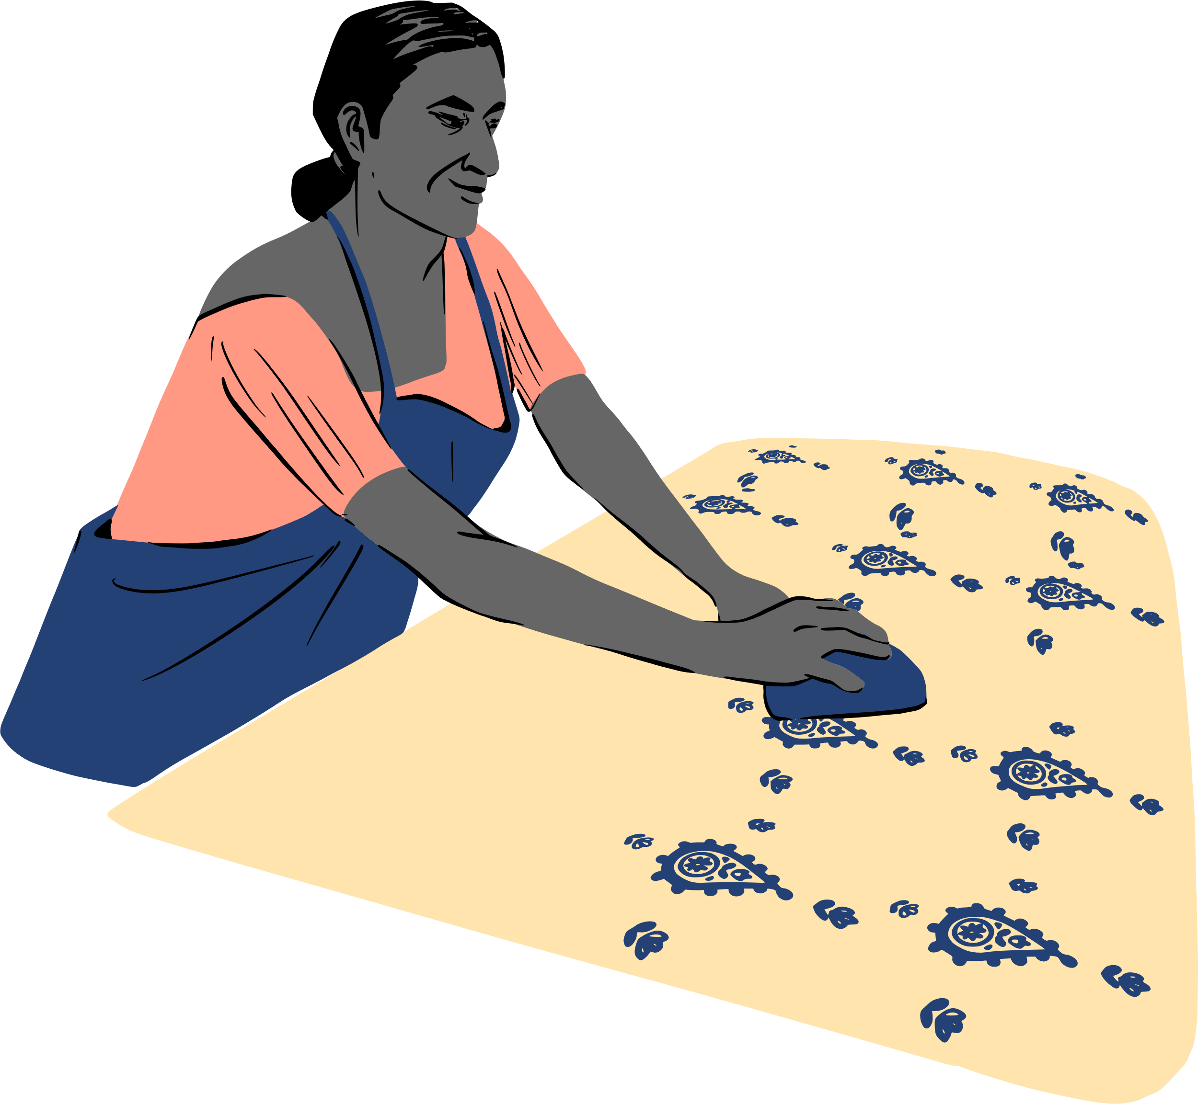
THREADS
AND TRENDS

Slide 6




JAZZ CLUB

Slide 7


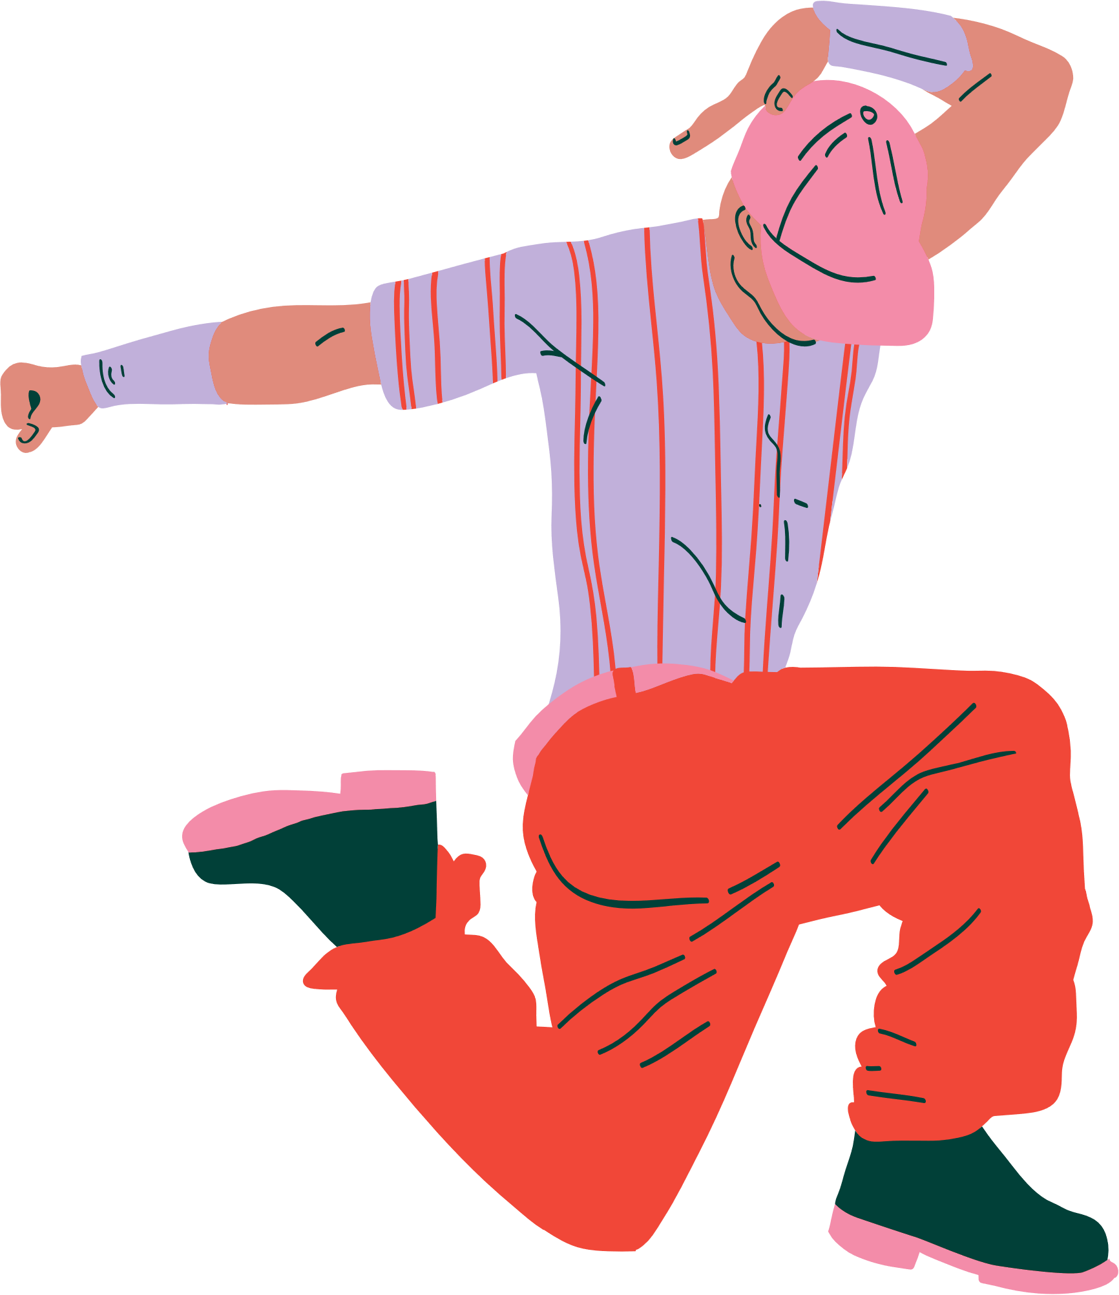

BREAKERS

Slide 8


SHAAM SHANDAAR

Slide 9


